Slide 1
Interoperability Advances using the Solor Knowledge Architecture

Slide 2
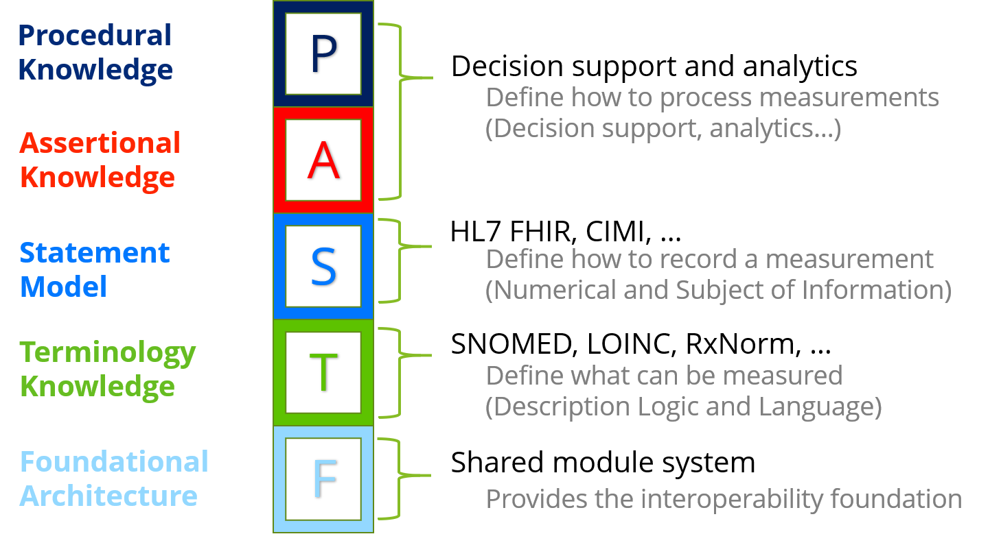
Knowledge Architecture

Slide 3
Knowledge Architecture
Clean of concerns between layers
Each layer builds on the preceding layers
Each layer must be sufficient to support the next one
P
Procedural Knowledge
Common elements of interoperability such as object identity, versioning, modularity, exchange paradigms, and knowledge representation. It includes
the foundation and building blocks of the common model;
how the repeatable transformation process of disparate standards into the common model promotes interoperability with other environments; and
how the modules of the architecture are tightly version controlled over time.
A
Assertional Knowledge
S
Statement Model
T
Terminology Knowledge
F
Architectural Foundation

Slide 4
Knowledge Architecture
P
Procedural Knowledge
Structured sets of medical terms and codes that define concepts of interest, including descriptions, dialects, language, and semantic hierarchy.
It includes SNOMED CT, LOINC, RxNorm,
It defines what valid codes or expressions may be used by higher level layers.
A
Assertional Knowledge
S
Statement Model
T
Terminology Knowledge
F
Architectural Foundation

Slide 5
Knowledge Architecture
Defines how data elements are combined to create a statement. It reuses artifacts defined in the Terminology Knowledge layer.
standards-based clinical statements like ANF and CIMI belong in this layer
Statement models may be implemented using HL7 V2, CDA, FHIR, etc.
P
Procedural Knowledge
A
Assertional Knowledge
S
Statement Model
T
Terminology Knowledge
F
Architectural Foundation

Slide 6
Knowledge Architecture
Makes use of Terminology and Statement Knowledge to specify non-defining facts that may be used by procedural knowledge algorithms based on relationships between data element.
It may be used to indicate what symptoms may be associated with a disorder or what treatment is optimal for a condition.
P
Procedural Knowledge
A
Assertional Knowledge
S
Statement Model
T
Terminology Knowledge
F
Architectural Foundation

Slide 7
Knowledge Architecture
Also known as imperative knowledge, is the knowledge exercised in the performance of some task, such as determining a hypertension treatment plan by analyzing a combination of a patients ANF statements, and the available Assertional Knowledge.
Responsible for information about standard ways to carry out specific procedures as well as other procedural guidelines, e.g. treatment protocols for diseases and order sets focused on particular patient situations.
Along with Assertional Knowledge, enables clinical decision support, quality measurement, and supports patient safety.
It relies on the architectural foundation and terminology layers, incorporates the statement model for information retrieval, and uses the assertional knowledge.
Includes clinical alert rules, reminders, etc. that trigger actions or recommend interventions.
P
Procedural Knowledge
A
Assertional Knowledge
S
Statement Model
T
Terminology Knowledge
F
Architectural Foundation

Slide 8
Applied Knowledge Architecture
Provides a

Slide 9
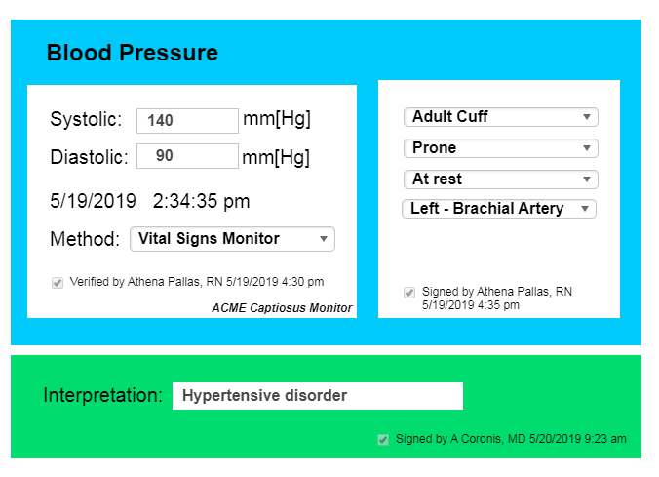
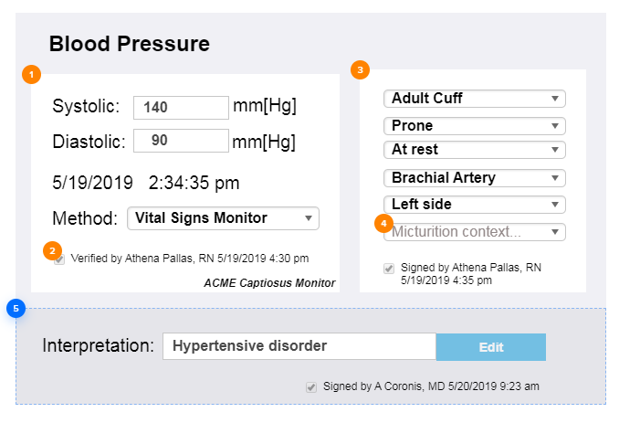
Source of standards-based clinical statement
EHR 1
EHR 2
Clinical Input/Display Format
FHIR resources/CDA docs/V2 messages
FHIR resources/ CDA docs/ V2 messages
Analysis Repository (FHIR API)
FHIR ANF –based query
Clinical Decision Support

Slide 10


Assessment
Questionnaire
FHIR resources/CDA docs/V2 messages
FHIR resources/ CDA docs/ V2 messages
ANF statements
derived from assessment questionnaire
Analysis Repository
FHIR API – using ANF

Slide 11



EHR System
FHIR resources/CDA docs/V2 messages
FHIR resources/ CDA docs/ V2 messages
Analysis Repository (FHIR API)
FHIR ANF –based query
Clinical
Decision Support

